Slide 1


Department of Computer Science and Engineering
EatGood ML-Driven Dietary Recommendation
Mrs. Divya.M M.E.,
Assistant Professor
Department of CSE
PAVENDHAN A
220701194
CSE

Slide 2
Problem Statement and Motivation
Growing Health Concerns: Increasing prevalence of lifestyle diseases and cardiovascular diseases due to poor dietary habits and sedentary lifestyle.
Lack of Personalized Diet Recommendations: Limited access to personalized meal plans tailored to individual health parameters such as age, weight, blood pressure, and blood sugar levels.
Technological Solutions for Better Health: Opportunity to leverage machine learning and health data to create personalized meal recommendations that can improve individual health outcomes.

Slide 3
Existing System
Several dietary recommendation platforms are available today, such as MyFitnessPal, Fitbit, and HealthifyMe. While these systems provide basic features like calorie tracking, meal logging, and fitness integration, they often fall short in delivering truly personalized recommendations. Most require manual data input and do not dynamically adapt to changes in the user's health, preferences, or lifestyle. MyFitnessPal and Fitbit, for example, focus heavily on tracking rather than personalized advice, while HealthifyMe offers some level of personalization but relies on human nutritionists and often restricts advanced features to premium users.

Slide 4
Objectives
Develop a Personalized Meal Recommendation System
Leverage Machine Learning for Health Data Analysis
Improve Nutritional Awareness
Enhance Health Management through Data-Driven Solutions

Slide 5
Abstract
This project creates a personalized meal recommendation system that leverages user health data, such as age, weight, blood pressure, and exercise habits. Using machine learning algorithms, the system provides tailored meal suggestions from a comprehensive food database, helping individuals meet their nutritional needs. The goal is to promote healthier eating habits and improve overall well-being through customized meal planning.

Slide 6
Proposed System
The proposed system will collect user health data, such as age, weight, blood pressure, cholesterol levels, and exercise habits, to recommend personalized meal plans. The system will use machine learning models to process the input data, match it against a dataset of available food items, and suggest meals that meet the user’s nutritional requirements. Additionally, the system will consider preferences and dietary restrictions, ensuring that the recommendations are practical and aligned with the user's health goals.

Slide 7
System Architecture

Slide 8
List of Modules
User Input & Validation Module: Collects and verifies user health data to ensure accuracy and completeness.
Data Preprocessing & Scaling Module:Prepares user and meal data by cleaning and scaling for effective analysis.
Meal Recommendation Engine :Matches user health profiles with suitable meals using nutritional filtering logic.
Visualization Module: Graphically presents recommended meals and their nutritional content.

Slide 9
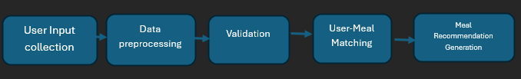
Functional Description for each modules with DFD and Activity Diagram
DFD DIAGRAM

Slide 10
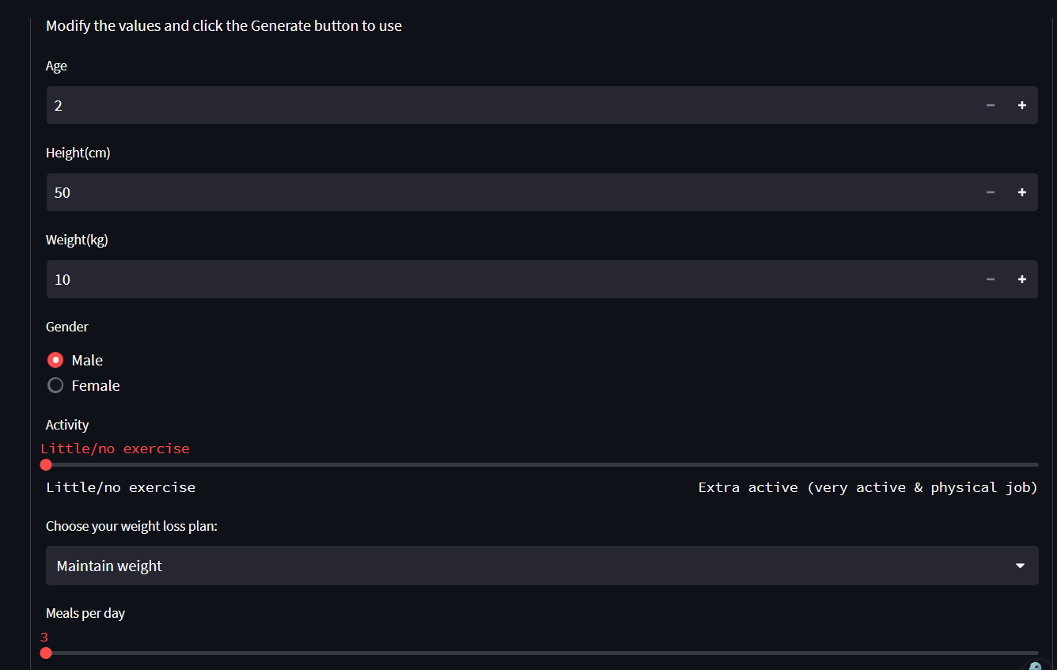
Implementation & Results of Module
This is the basic interface of system.

Slide 11
Conclusion & Future Work
This project successfully delivers a personalized meal recommendation system that utilizes user health metrics, dietary preferences, and lifestyle factors to suggest nutritionally appropriate meals. By applying data-driven insights, it promotes healthier eating habits tailored to individual needs. In the future, this system can be enhanced by incorporating real-time feedback, expanding the food and nutrition database, accommodating disease-specific dietary plans, and developing a web or mobile application for broader accessibility and ease of use.

Slide 12
References
Trattner, C., & Elsweiler, D. (2017). Food Recommender Systems: Important Contributions, Challenges and Future Research Directions, 27(3–5),331–392.
Ge, M., Elahi, M., Fernández-Tobías, I., Cremonesi, P., & Jannach, D. (2015). Leveraging Multi-Source Data in Food Recommender Systems, 313–316.
Kant, A. K., & Graubard, B. I. (2018). Levels of Protein Intake and Food Sources in the US: NHANES 2003–2014. Nutrients, 10(12), 1853.
U.S. Department of Agriculture, Agricultural Research Service. (2019). FoodData Central. Retrieved from https://fdc.nal.usda.gov

Slide 13
Thank You

